Slide 1
Brewing Growth: Unveiling Espresso Oasis Sales Dashboard Insights

Slide 2
Agenda
Objective
Background
Key findings
Recommendations
Appendix:
Data methodology

Slide 3
Objective
Sales Over Time: Develop a time-series visualization to showcase the total sales trends over a selected period, enabling the identification of peak sales times and potential areas for improvement.
Geographical Analysis: Implement a country-based visualization to display total sales by country, helping Café Espresso Oasis understand regional variations and target areas for potential growth.
Top Customer Analysis: Create visualizations to identify and showcase the top 5 customers based on their purchasing history, allowing the café to tailor promotions and engagement strategies for these key customers.
Interactive Slicers: Implement slicers for timeline selection, loyalty status (loyal vs. non-loyal customers), coffee bean size, and coffee type, providing users with the flexibility to analyze sales data based on specific criteria.
Loyalty Classification: Utilize data to categorize customers as loyal or non-loyal based on predefined criteria, enabling targeted marketing efforts towards retaining and growing the loyal customer base.
Coffee Type Impact: Analyze how the type of coffee affect sales, providing insights into product preferences and informing inventory management strategies.

Slide 4
Background
Café Espresso Oasis is looking to enhance its business intelligence and decision-making capabilities by leveraging data analytics in their coffee sales operations.
The company wants to develop a comprehensive Coffee Sales Analytics Dashboard that provides key insights into various aspects of their sales performance.
The dashboard should encompass visualizations and interactive elements to empower stakeholders in making informed decisions.

Slide 5
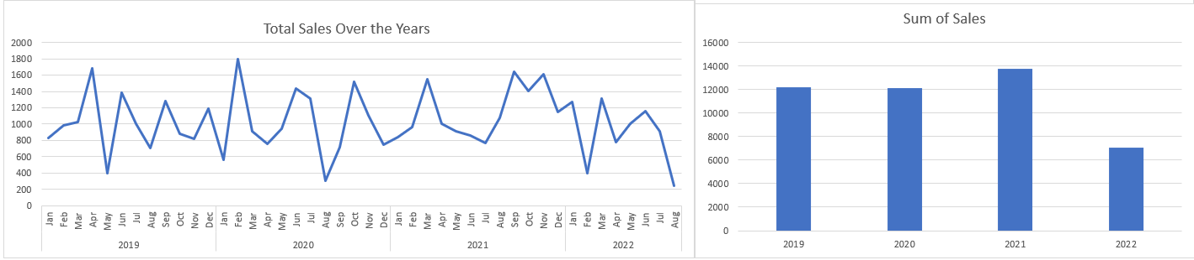
Key Findings
Total Sales Over Time:
The business has seen the highest sales in the year 2021 followed by 2019 and 2020.
The year 2022 observed the minimum sales.
Out of all the months 2020 Feb observed the maximum sales and Aug 2022 observed the minimum sales.

Slide 6
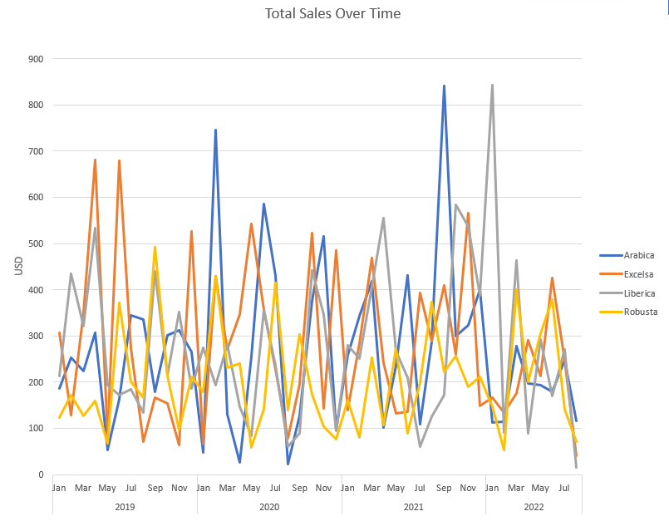
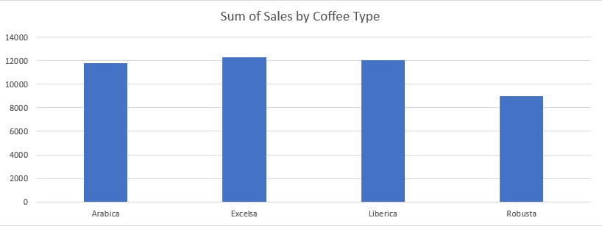
Key Findings
Total Sales Over Time By Coffee Type:
Excelsa & Liberica account for the highest sales respectively followed by Arabica.
Robusta has the least sales amongst all the Coffee types.
Excelsa’s demand was the highest in 2019 April & June whereas Liberica was the highest in demand for the month of Jan 2022 .
There was a huge demand for Arabica in the month of Sep 2021.

Slide 7
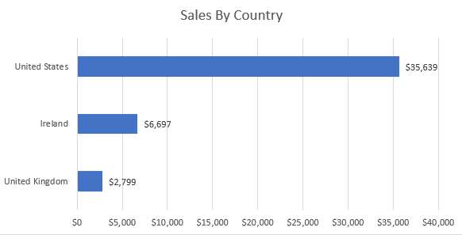
Key Findings
Total sales by country:
The United States of America account for the highest sales.
Ireland & United Kingdom are behind them by a huge margin.

Slide 8
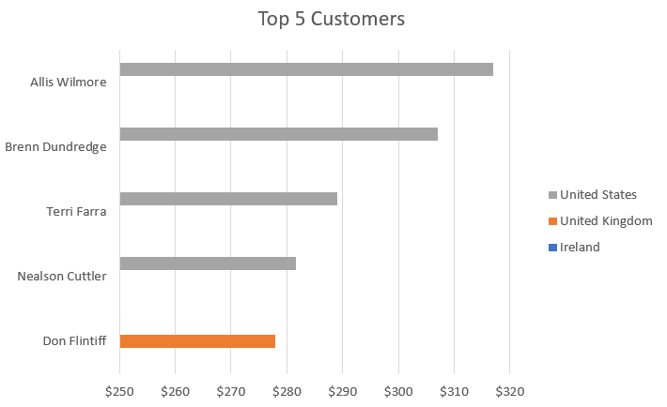
Key Findings
Total 5 Customers:
Out of the top 5 customers the top 4 belong to the United States of America.
Only one customer of United Kingdom is present in this chart and no customer of Ireland is present.

Slide 9
Recommendations
The business should look at the dashboard for doing the root cause analysis for the time periods having low sales.
The business should also look for the time periods having good sales and adhere to the strategies which led to the high sales .
The business should come up with strategies to boost the sales of the coffee type Robusta as it has the least sales amongst all the Coffee types.
By looking at the dashboard it is discernible that some coffee types have high sales in some particular time periods. The business should have them in inventory accordingly.
Since the United States of America account for the highest sales and also out of the top 5 customers the top 4 belong to the United States of America, they should be catered well and parallelly, the business should come up with strategies to boost their operations in United Kingdom and Ireland.
The business should take full advantage of the slicers to analyze sales data based on specific criteria and tailor strategies for growth accordingly.

Slide 10
Appendix
Data Methodology:
Data cleaning & transformation: Microsoft Excel
Data visualization: Microsoft Excel

Slide 11
Thank you

